Slide 1

Security Controls in Shared Source Code Repositories
Kypton Lantz September 30, 2025 CSD380-O307 DevOps (2261-DD) Module 11.2 Presentation

Slide 2
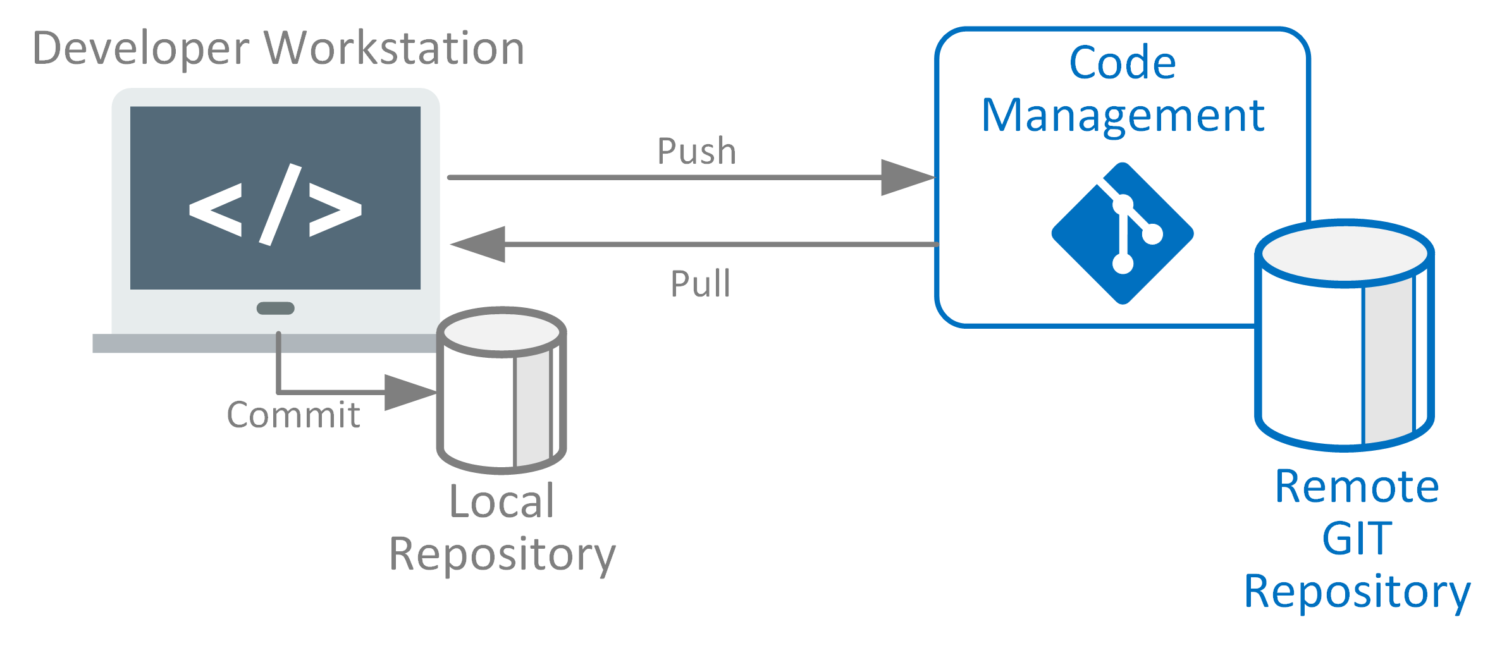
What is a Shared Source Code Repository?
A repository (repo) is where developers store, manage, and collaborate on code. Examples: GitHub, GitLab, Bitbucket
Shared repos allow multiple developers to contribute and track changes
Important for teamwork but must be carefully secured because they store valuable code and project history

Slide 3
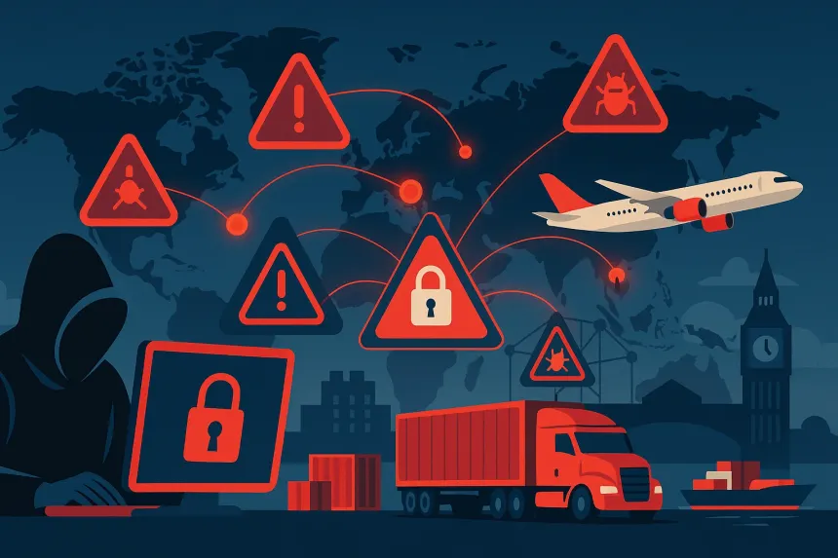
Why Security Matters
Repos hold the ‘blueprints’ for software, making them high-value targets
Risks: leaks of secrets, malicious code changes, compromised accounts
Attackers may compromise the software supply chain by inserting harmful code before the software reaches real users
Real-world attacks, like the SolarWinds breach, show why repository security is critical
3

Slide 4

Access & Identity Controls
Least Privilege: give people only the permissions they need
Require multi-factor authentication (MFA): password plus another factor (like a phone code)
Use single sign-on (SSO) so users log in through a central identity system
Avoid long-lasting access token; prefer short-lived ones
Audit access regularly to remove unused accounts
4

Slide 5
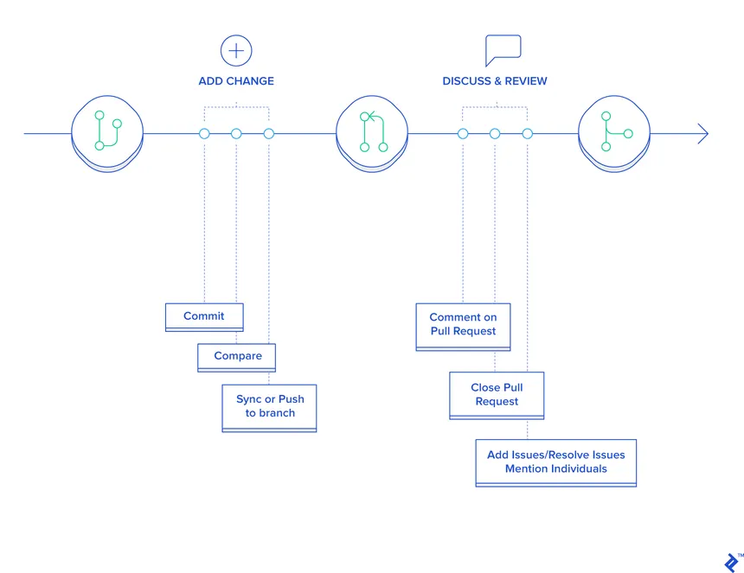
Workflow & Change Controls
Protect important branches (e.g., main or production) so no one can push changes directly
Require pull requests (PRs) so all changes are reviewed before merging
Code reviews: another developer checks for mistakes/security
Use signed commits/tags to verify changes come from trusted developers
Run automated checks (tests, security scans) before merging changes.
5

Slide 6
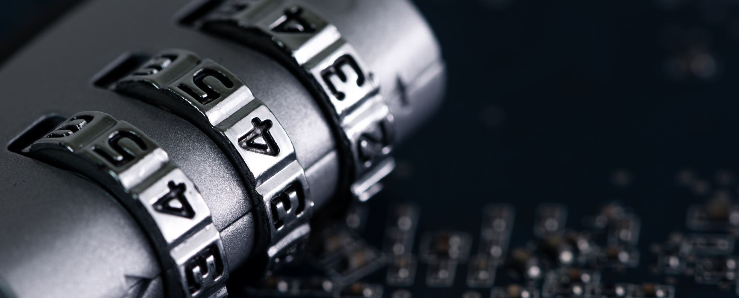
Secrets Management
Secrets: passwords, API keys, tokens should never stored in code
Use secret scanning tools to catch mistakes
Store secrets safely in a vault or password manager
If a secret is leaked, rotate it immediately to prevent misuse

Slide 7
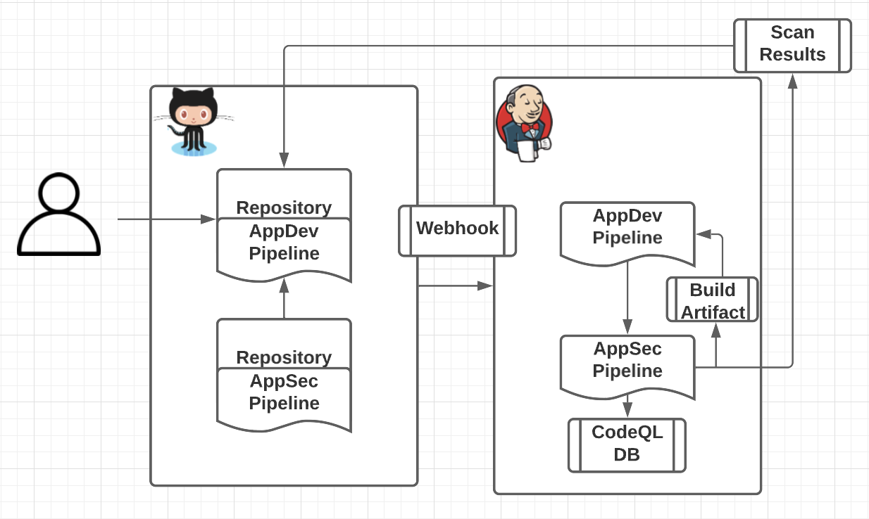
Dependencies & CI/CD Security
Dependencies: external packages/libraries. Use trusted versions.
Pin dependency versions to prevent unexpected updates
CI/CD: automated builds and testing must be secured
Harden pipelines by isolating environments and restricting permissions

Slide 8

Monitoring & Incident Readiness
Audit logs: who changed what and when
Continuous scanning for security problems
Health dashboards: show compliance with security rules
Prepare an incident response plan so teams know how to respond if a breach happens (e.g., rotate secrets, rebuild software from a trusted state, a playbook of guidelines)
8

Slide 9

Practical Checklist
MFA + SSO + least privilege access
Branch protection + pull request reviews
Secret scanning + secure storage
Dependency pinning + vulnerability checks
CI/CD hardening + signed releases
Logging + incident playbook

Slide 10
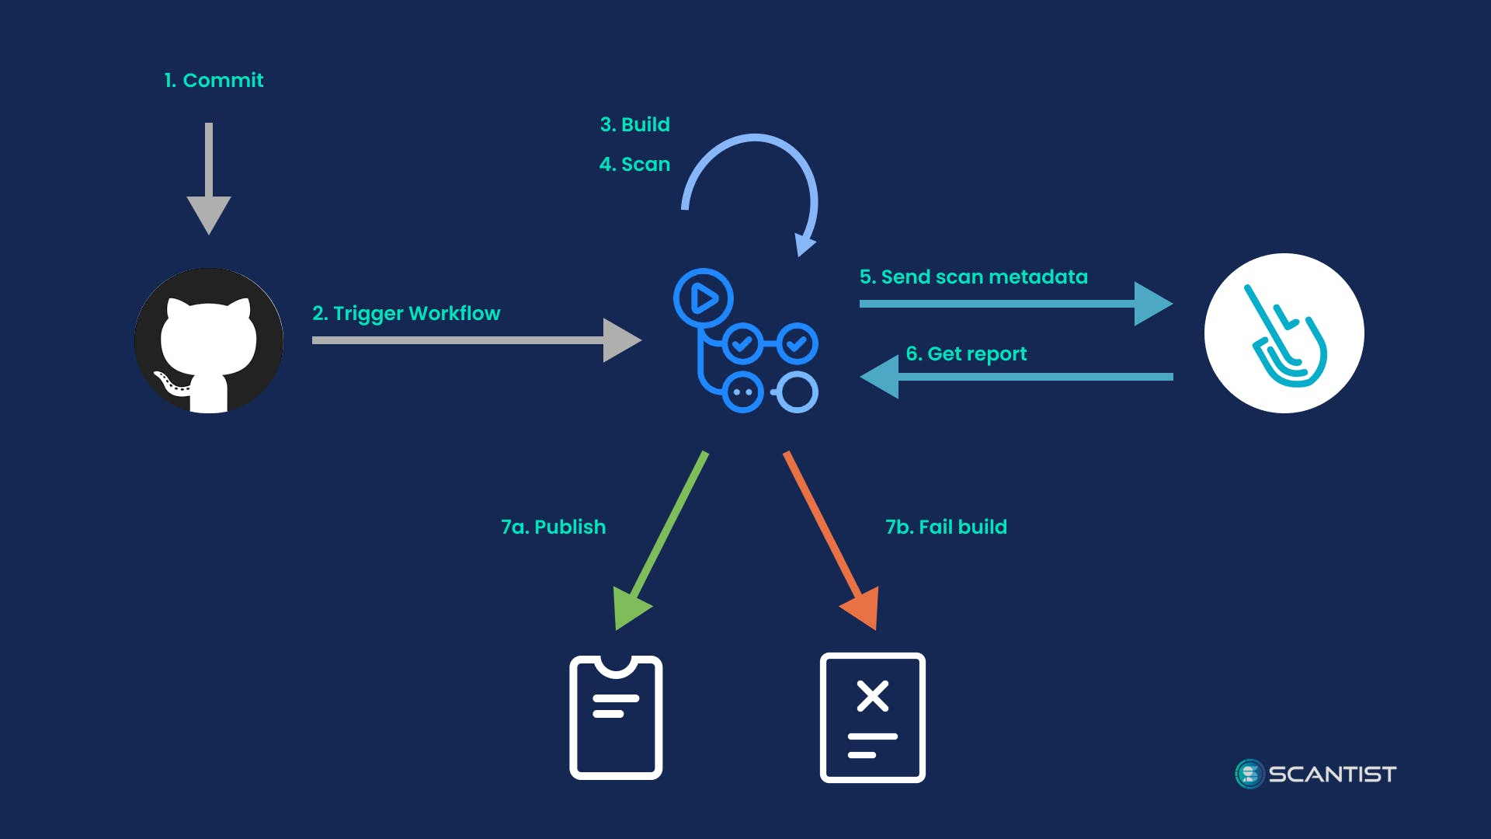
Wrap Up
Shared repos are powerful tools, but insecure repos put software at risk
Students and developers must learn basic controls to prevent breaches
Start simple: enable MFA, require reviews, scan for secrets

Slide 11
References
National Institute of Standards and Technology. (2022). Secure Software Development Framework (SSDF) Version 1.1: Recommendations for mitigating the risk of software vulnerabilities (NIST SP 800-218). U.S. Department of Commerce. https://doi.org/10.6028/NIST.SP.800-218
GitHub Docs. (n.d.). About secret scanning. GitHub. https://docs.github.com/code-security/secret-scanning/about-secret-scanning
Checkmarx. (2025, June 11). 12 best practices for secure code repositories (2025 guide). Checkmarx Blog. https://checkmarx.com/supply-chain-security/repository-health-monitoring-part-2-essential-practices-for-secure-repositories/
Open Web Application Security Project (OWASP). (n.d.). CI/CD Security Cheat Sheet. OWASP Cheat Sheet Series. https://cheatsheetseries.owasp.org/cheatsheets/CI_CD_Security_Cheat_Sheet.html
National Cyber Security Centre (NCSC). (n.d.). Protect your code repository. NCSC — UK. https://www.ncsc.gov.uk/collection/developers-collection/principles/protect-your-code-repository
Center for Internet Security. (n.d.). CIS Critical Security Controls (v8). CIS. https://www.cisecurity.org/controls/

Slide 12
Thank you
Kypton Lantz September 30, 2025 CSD380-O307 DevOps (2261-DD) Module 11.2 Presentation

